Slide 1
Major Project Phase-I
Course Code: 18EE706

Slide 2
Major Project Phase-I
Dashboard of an Electric Vehicle
Team members:
1. Shetty Roshan Ravi - 4nm18ee051
2. Sreedev S. Nair - 4nm18ee058
3. Rishikesh Kumar C. - 4nm18ee040
4. Adi Thejaswi – 4nm18ee001
Project Guide:
Dr. Suryanarayana K.

Slide 3
Major Project Phase-I
Objectives of the Project
To a create a robust interactive dashboard for an Electric Vehicle.
To integrate useful features like:
Parking Assist
Battery Indicator
Speedometer
Odometer
Music Player
Bluetooth
System Check
A/C

Slide 4
Progress
Completed the Parking assist feature.
Speedometer feature is Completed.
Battery indicator feature is almost done only Battery vs Time chart is remaining.
A/C feature is almost done only slider control for speed is remaining.
Odometer feature is almost done only Distance vs Time chart is remaining.

Slide 5
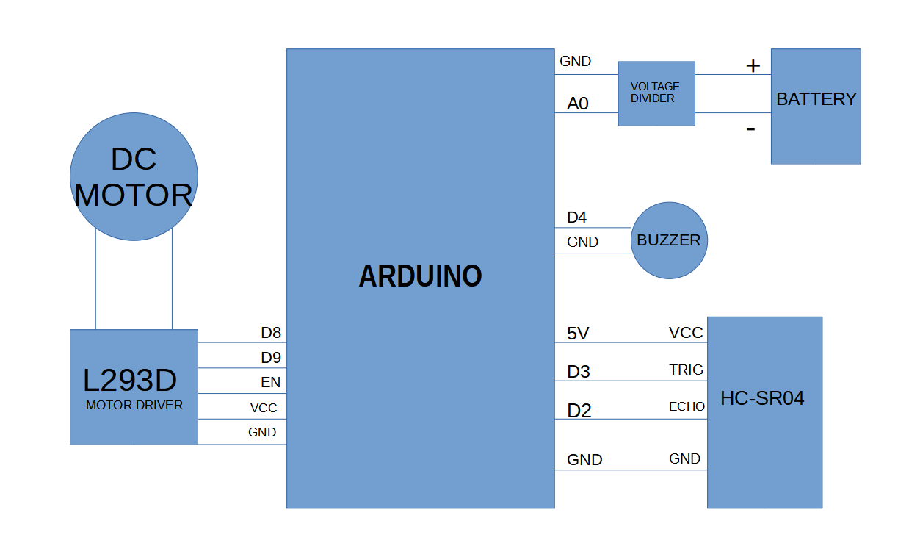
Major Project Phase-I
Block Diagram

Slide 6
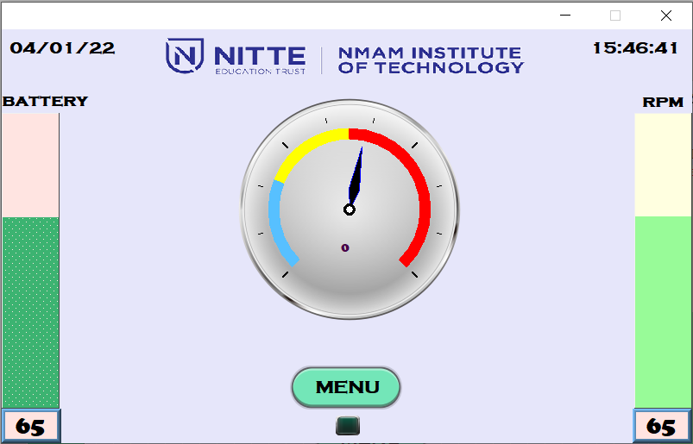
Screenshots of HMI

Slide 7
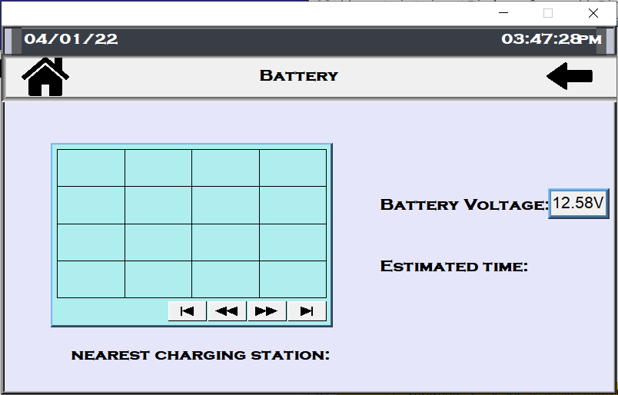
Screenshots of HMI

Slide 8
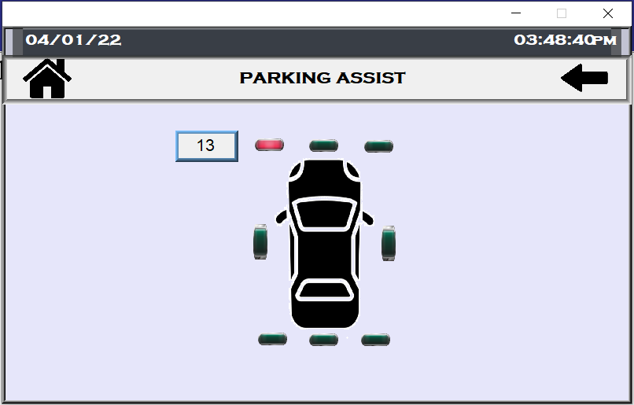
Screenshots of HMI

Slide 9
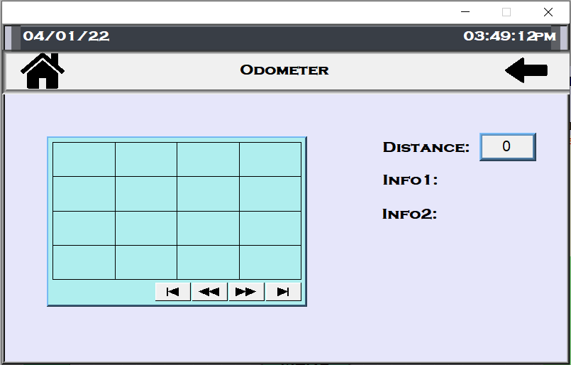
Screenshots of HMI

Slide 10
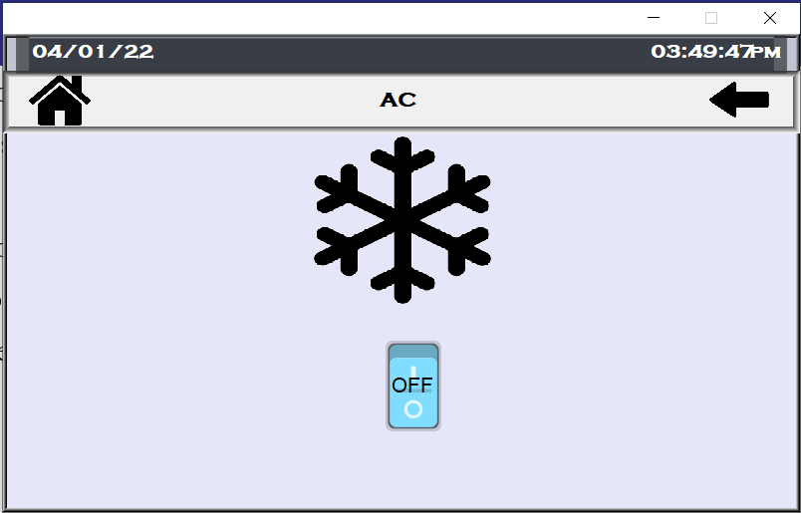
Screenshots of HMI

Slide 11
Calculation
For Ultrasonic Sensor:
distance = duration * 0.034 / 2
For Battery Voltage Measurement:
output=(analog input value*5*multiplier)/1024
Battery percentage=((output-11)/2.5)*100

Slide 12
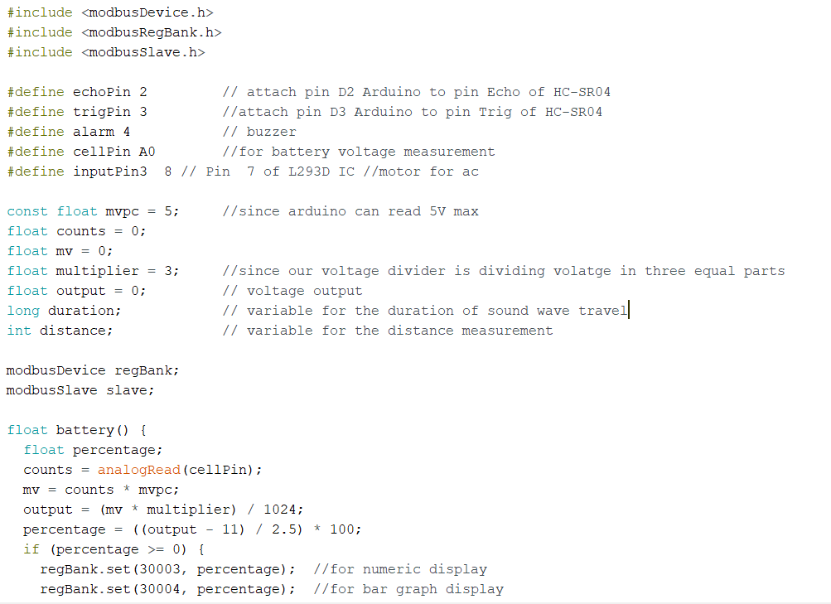
Code Screenshot

Slide 13
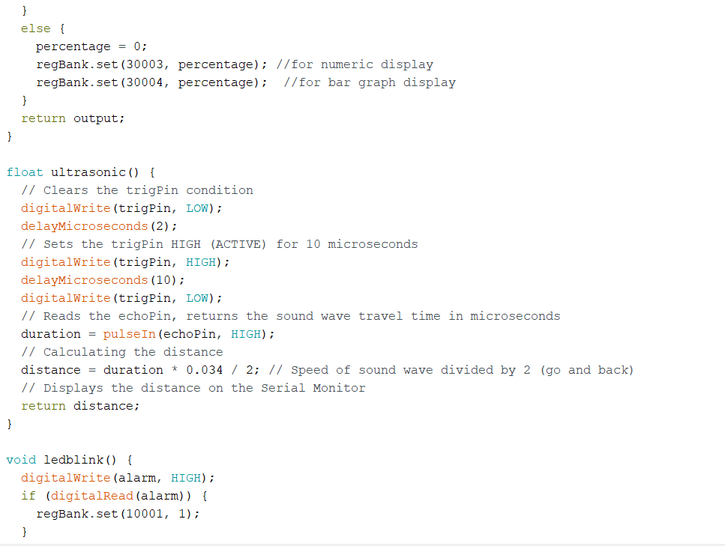

Slide 14
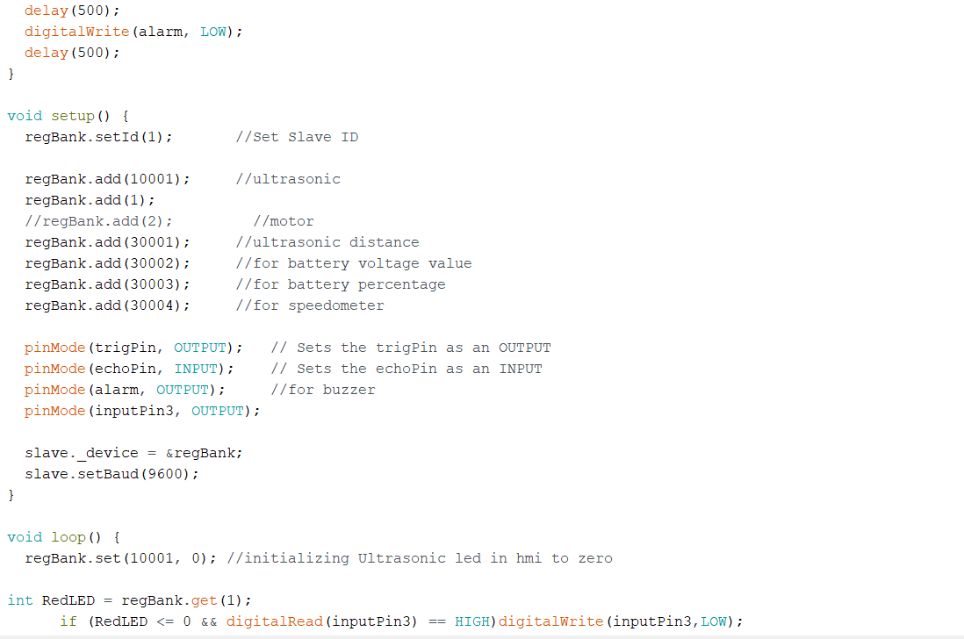

Slide 15
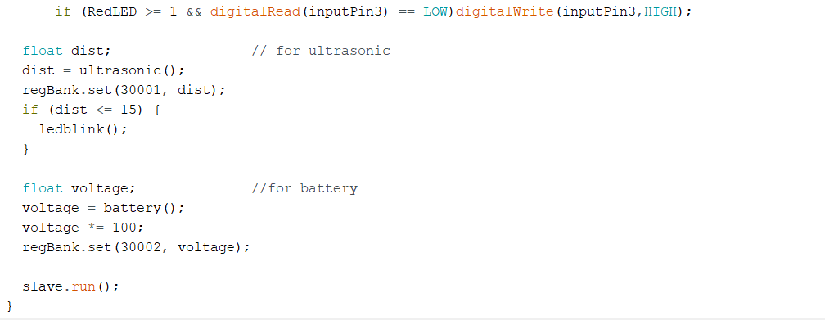

Slide 16
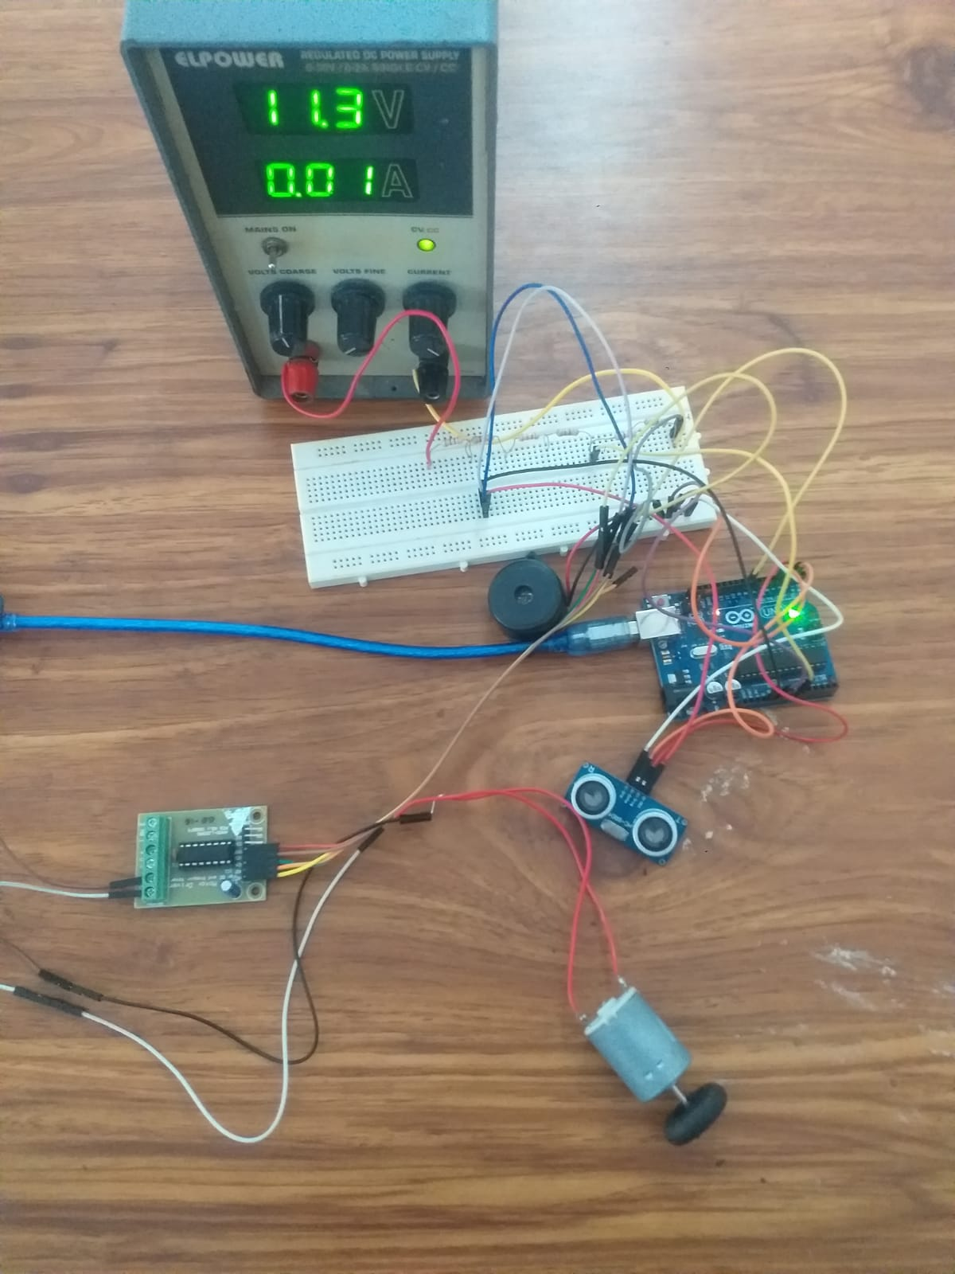

Slide 17
Thank You

